Slide 1
Chapter 9
Transport Layer
Module 14: Transport Layer
Introduction to Networks v7.0 (ITN)

Slide 2
Objectives
Roles of Transport Layer
Two protocols involved: TCP and UDP
Differences between TCP and UDP

Slide 3
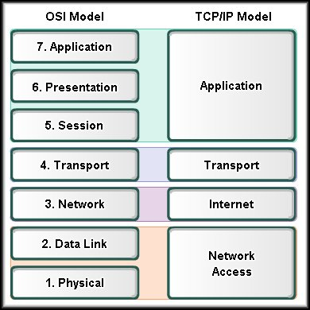

Slide 4
Transport Layer
The Transport Layer is responsible for establishing
temporary communication session between two
APPLICATIONS and delivering data between them.
TCP/IP uses two protocols to achieve this:
Transmission Control Protocol (TCP) → segment
User Datagram Protocol (UDP) → datagram

Slide 5
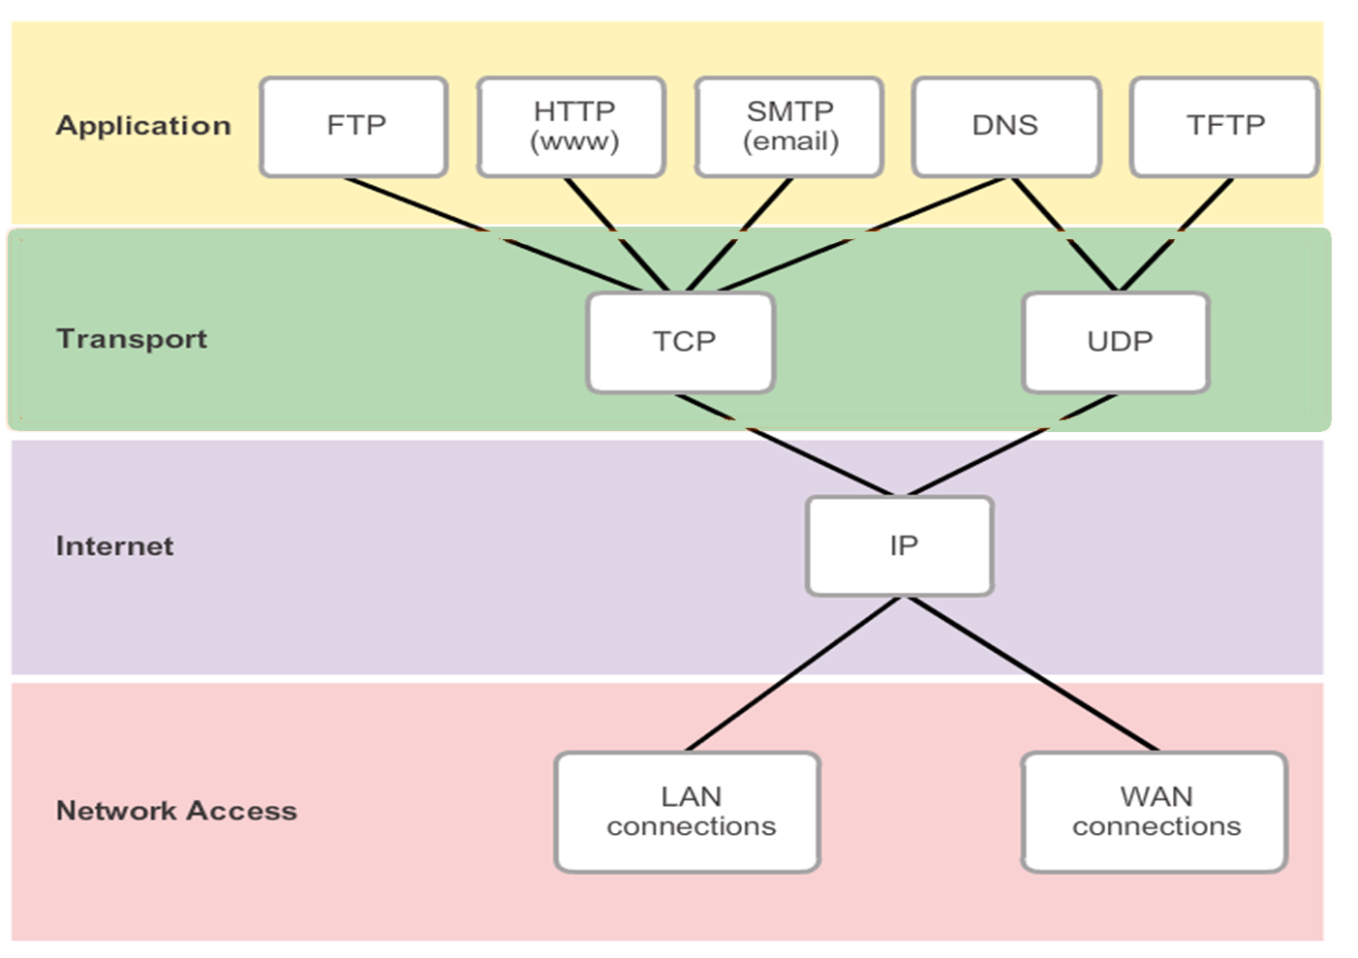

Slide 6
TCP Protocol
Connection-oriented protocol
Guaranteed delivery (involves the use of acknowledgement and retransmission)
Provide flow control and windowing
Provide ordered delivery
Quality data transmission but slower
High overhead

Slide 7
Cont’d…
Applications that use TCP protocol:
Web Browser
Email
File Transfer
Telnet
Concern more on the quality of transmission
instead of speed

Slide 8
UDP
Connectionless protocol
Does not provide guaranteed delivery (subject to losses) - best effort delivery
Does not provide flow control and windowing
Does not provide ordered delivery
Faster but low quality data transmission
Low overhead

Slide 9
Cont’d…
Applications that use UDP protocol:
DNS
Video streaming
DHCP
Online Game
Concern more on the speed of transmission
instead of quality

Slide 10
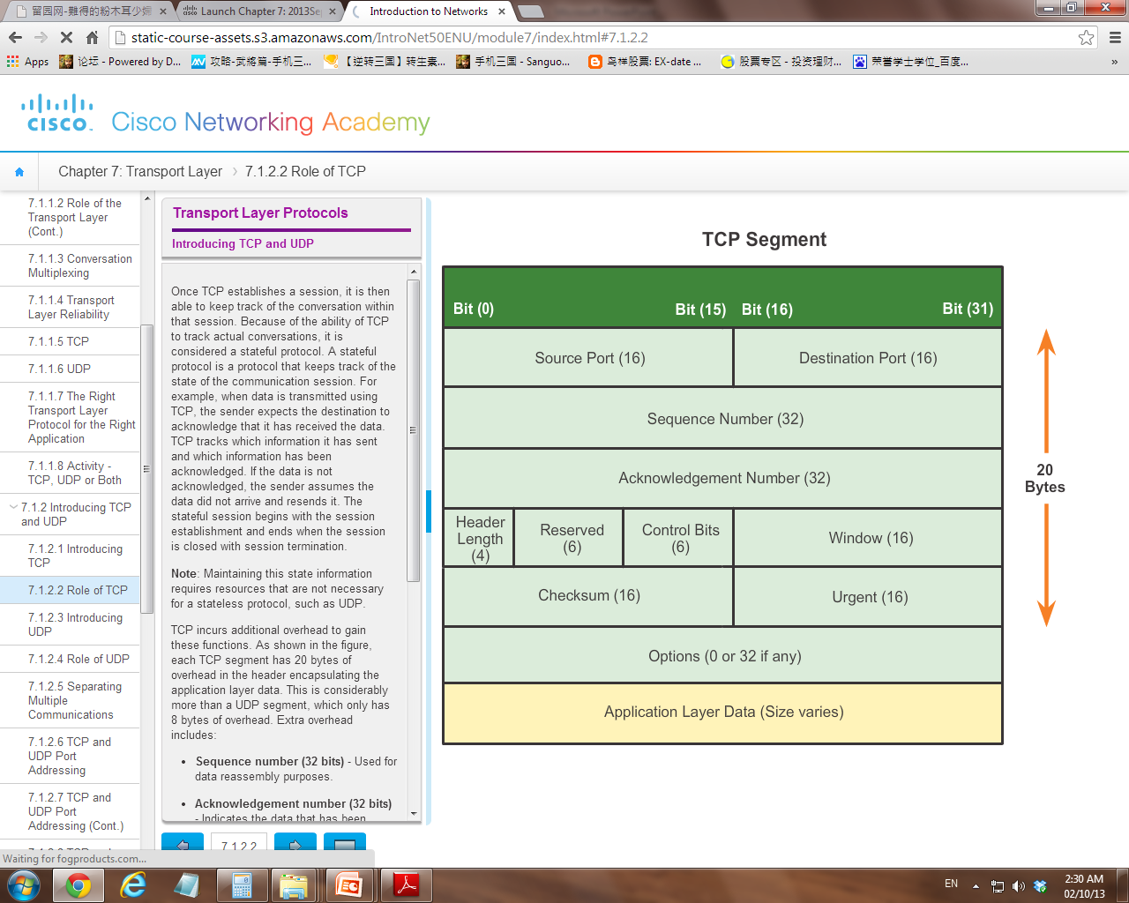
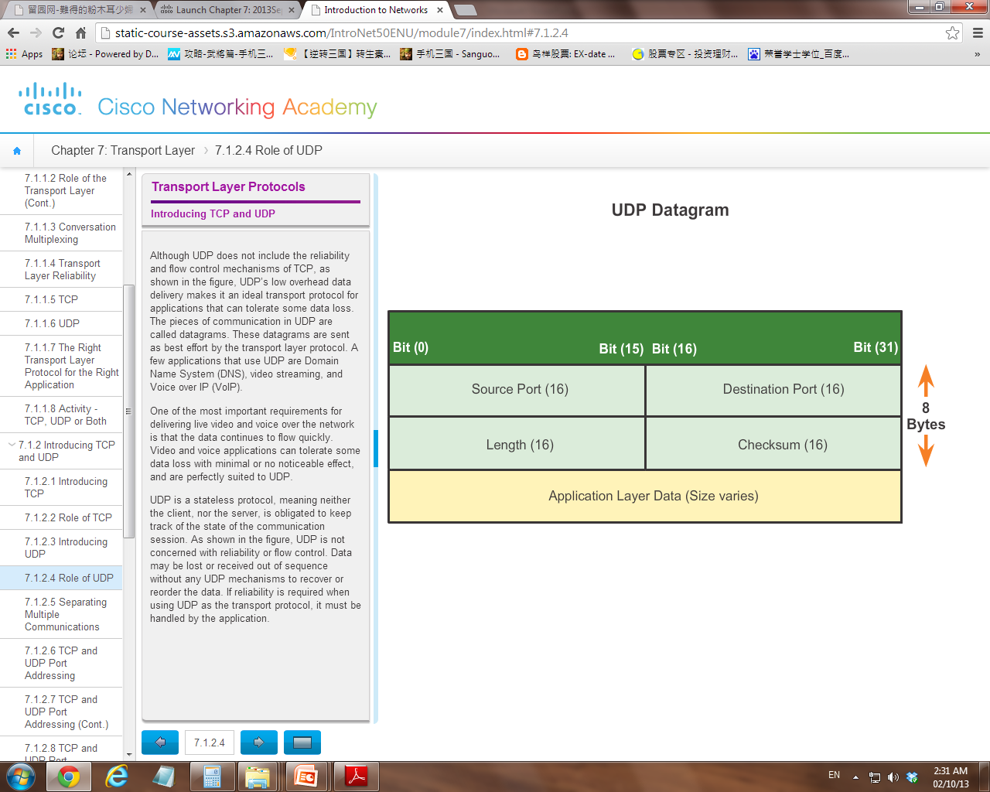

Slide 11
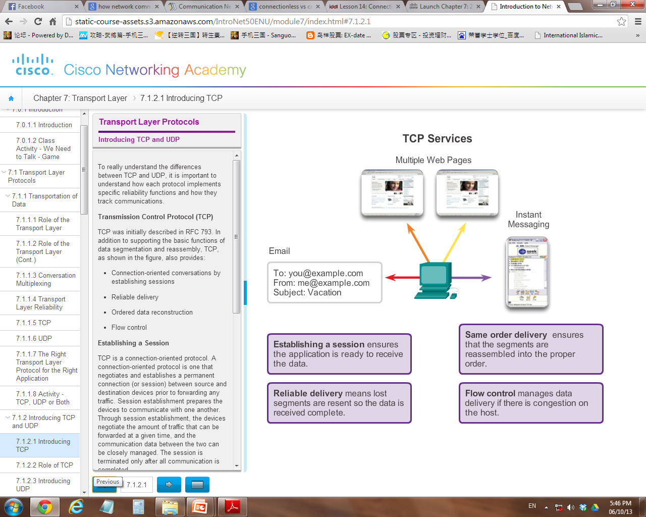
Differences of TCP and UDP

Slide 12
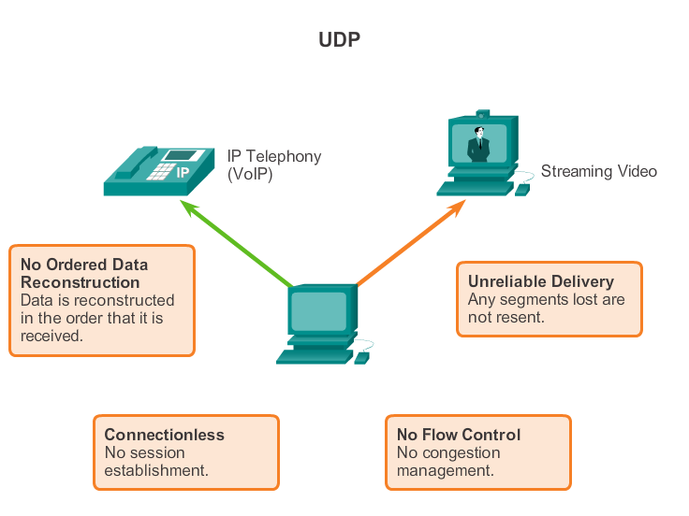

Slide 13
Roles of Transport Layer
Tracking individual conversation
Segmentation
Establish / Terminate TCP connection (TCP only) ***
Ensure Reliable Delivery (TCP only) ***
Identifying the correct application

Slide 14
Cont’d…
Tracking individual conversation
When a source application communicates with a destination application, it is known as a conversation
A host may have multiple network applications running at the same time and communicating with one or more applications on a remote host
Transport Layer is responsible in maintaining and keep tracking the conversations

Slide 15
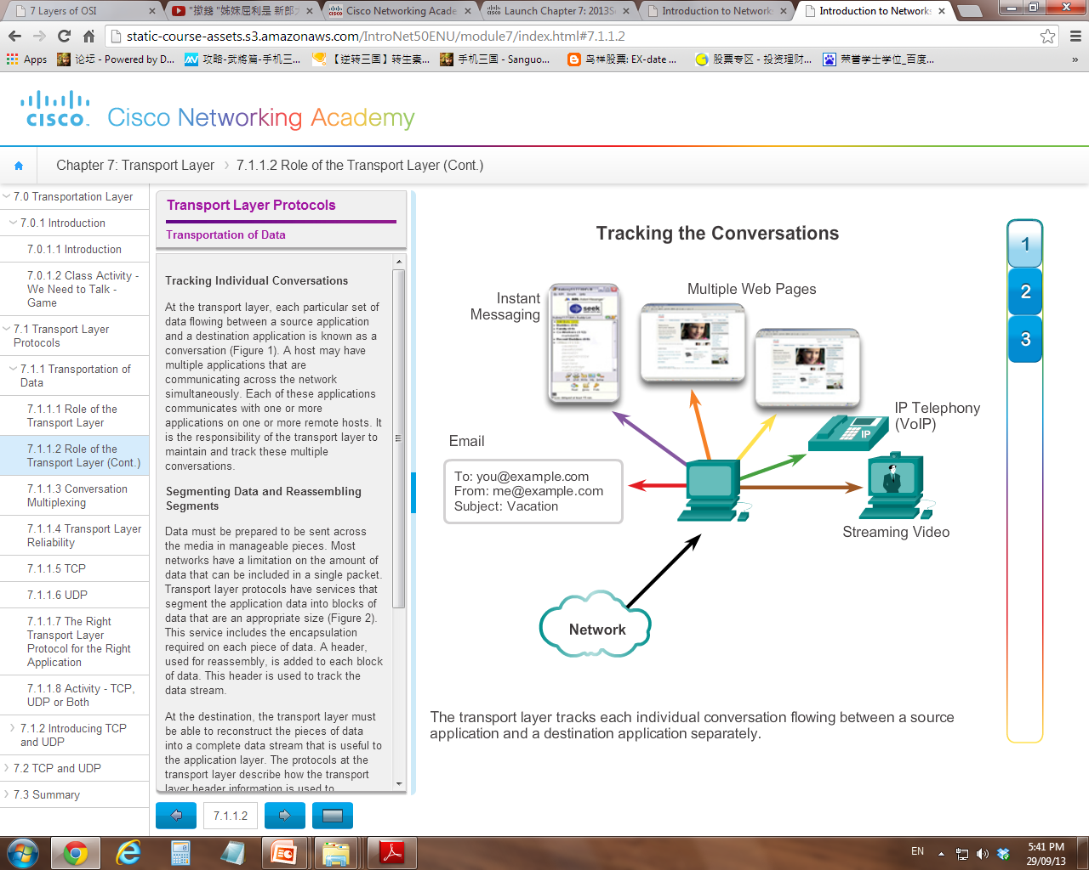

Slide 16
Cont’d…
Segmentation
Data stream to be transmitted will be broken into smaller, manageable pieces (segment/datagram)
A TCP header (that consists of Sequence No.) , used for reassembly, will be encapsulated to each block of data.
At the destination, the Transport Layer must will reconstruct (reassembled) the pieces of data into a complete data stream that is useful to the Application Layer.

Slide 17
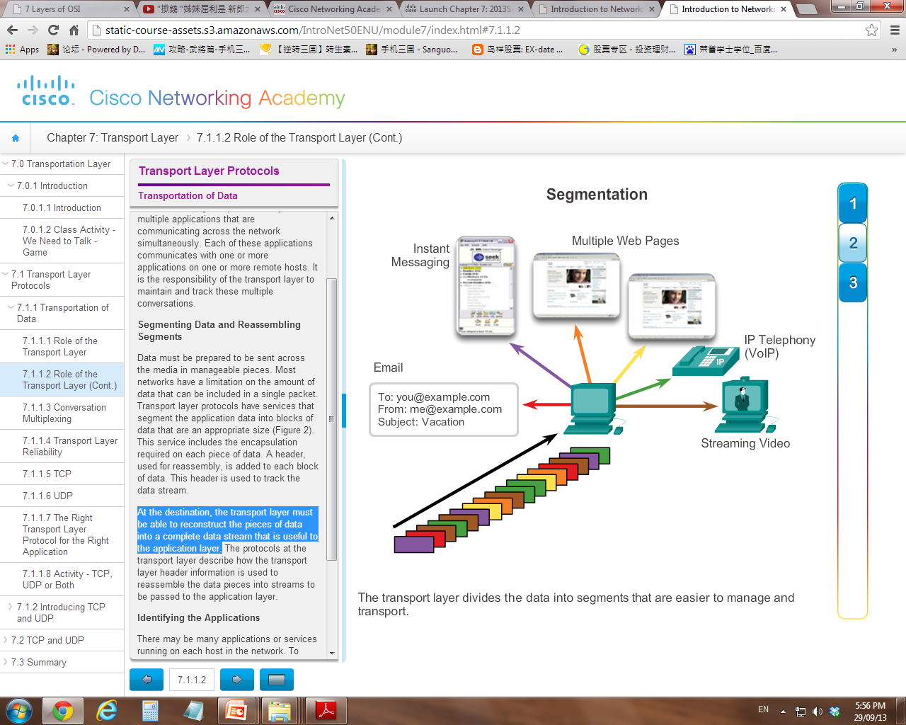

Slide 18
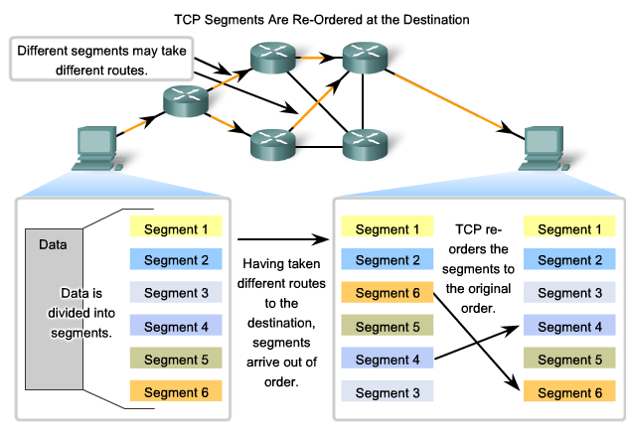

Slide 19
Why Segmentation?
Sending of data as one complete communication stream, could use all of the available bandwidth and prevent other communications from occurring at the same time. It also makes error recovery and retransmission of damaged data difficult.
For example, a streaming video, the media would be completely consumed by the one communication stream instead of shared. You could not receive emails, chat on instant messenger, or view web pages while viewing the video.

Slide 20
Cont’d…
Establish / Terminate TCP connection
(applicable to TCP only)
TCP is a connection-oriented protocol (UDP is connectionless)
Establishes a connection (or session) between source and destination devices prior to forwarding any traffic.
After the communication is completed, the sessions are closed and the connection is terminated

Slide 21
Why session establishment?
Through session establishment, the devices negotiate the amount of traffic that can be forwarded at a given time, ensure both parties are ready and the communication data between the two can be closely managed.

Slide 22
Cont’d…
TCP uses a process called a three-way handshake to create a new TCP connection
Step 1. The initiating client requests a client-to-server communication session with the server.
Step 2. The server acknowledges the client-to-server communication session and requests a server-to-client communication session.
Step 3. The initiating client acknowledges the server-to-client communication session. Session set up complete.

Slide 23
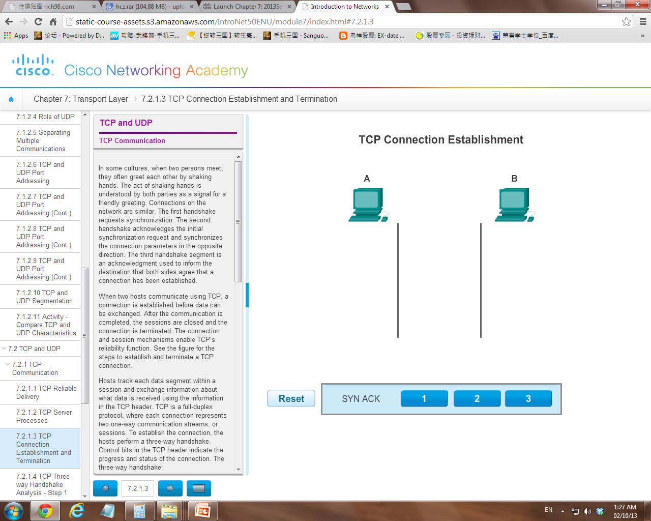
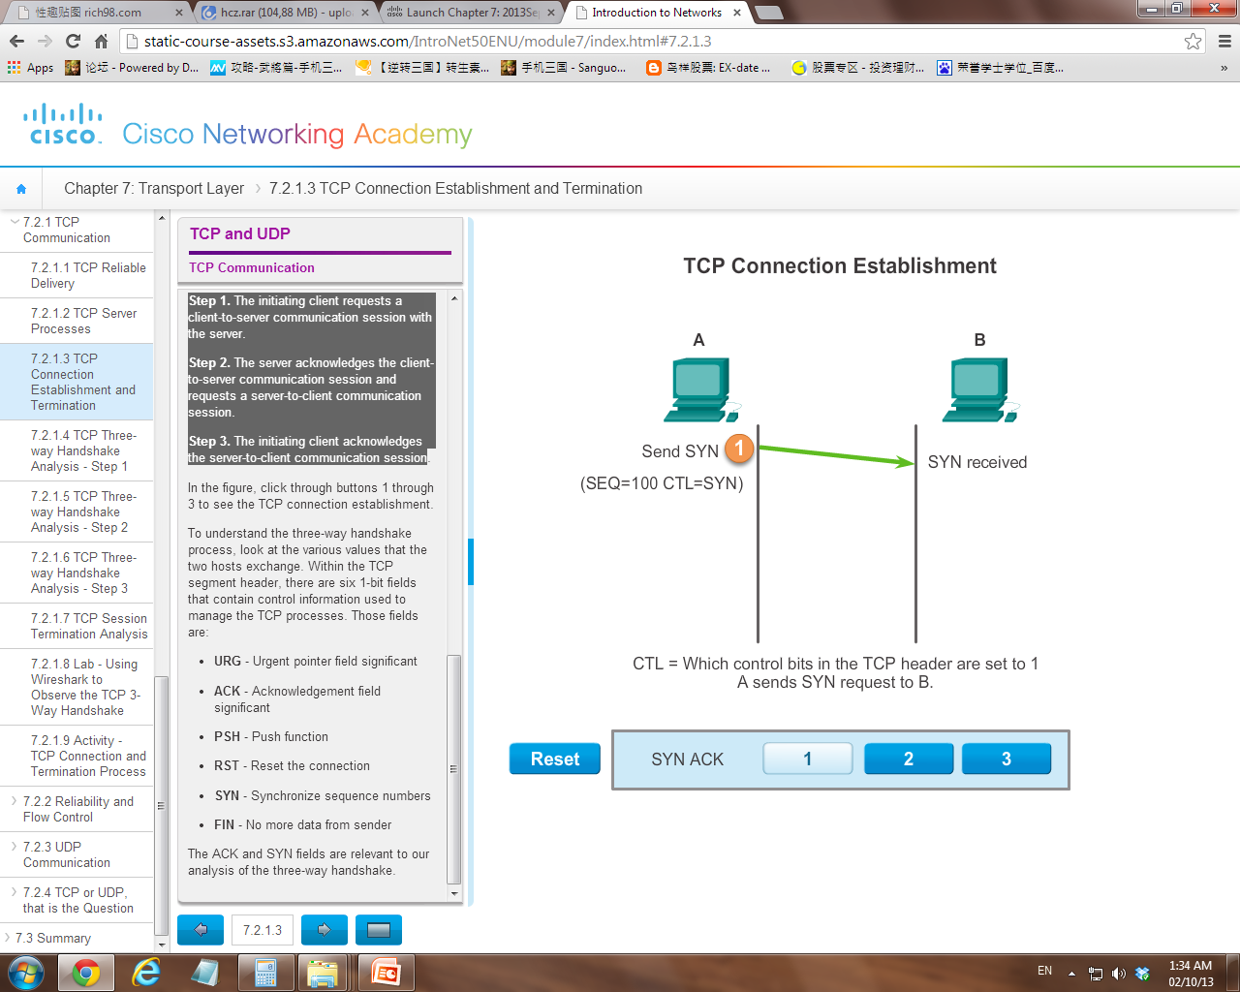
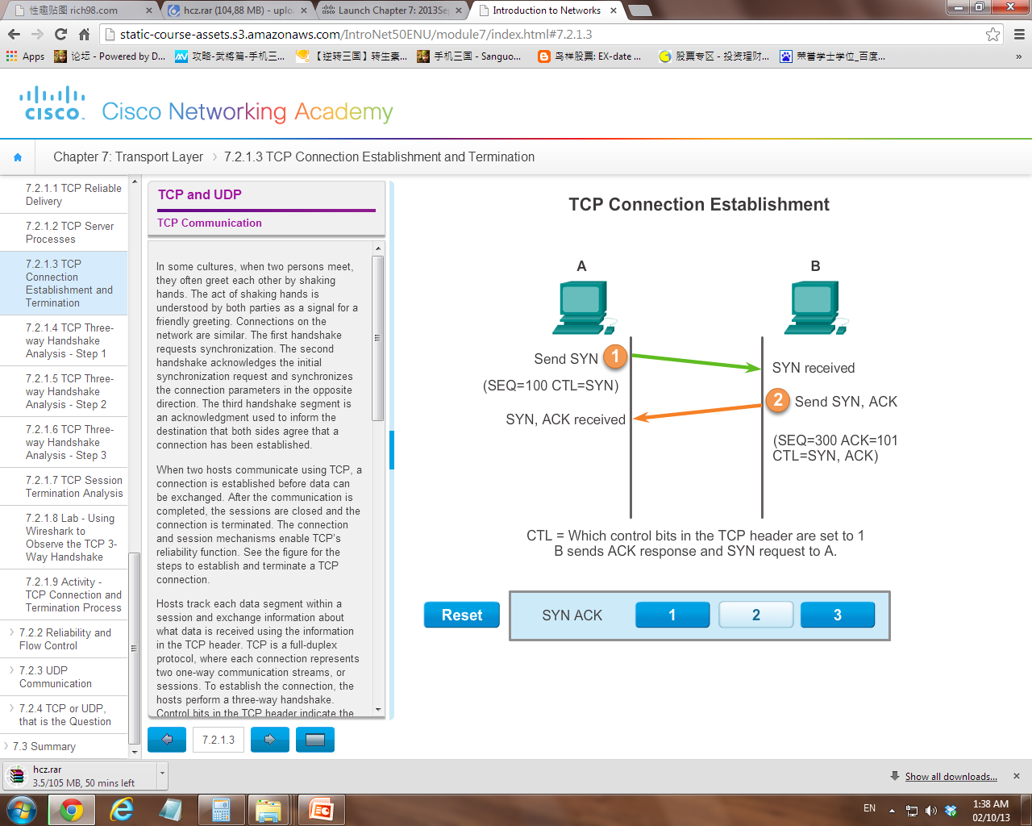
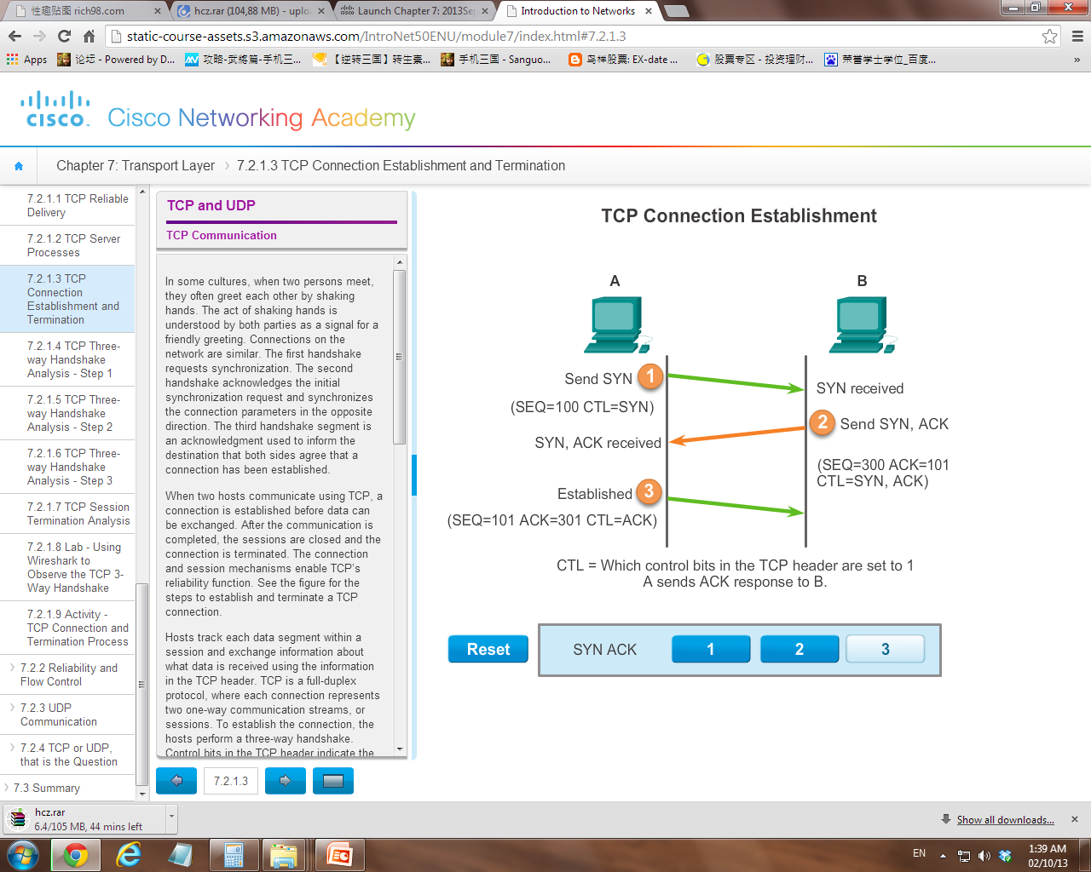
Aka “SYN, ACK-SYN, ACK”

Slide 24
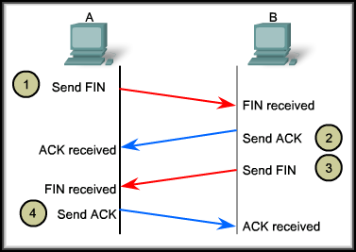
TCP Session Termination
Aka “FIN, ACK-FIN, ACK”

Slide 25
SYN, ACK and FIN status are
set in Control Bits

Slide 26
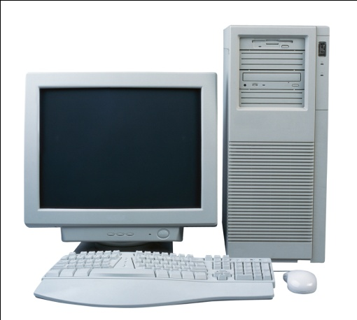
Cont’d…
UDP does not establish session before communication
Cut the SYN/ACK crap, I don’t care.
When data is ready and port is indentified,
I will send the data

Slide 27
Cont’d…
Reliable Delivery (applicable to TCP only)
Data can become corrupted or lost during transmission. Source device need to retransmit any data that is lost.
Reliability processes place additional overhead on the network resources as additional operations need to be done.

Slide 28
Cont’d…
TCP is a complete, full-featured protocol that provides reliability transmission that includes:
Segment Reordering
Segment Acknowledgement
Segment Retransmission
Flow Control

Slide 29
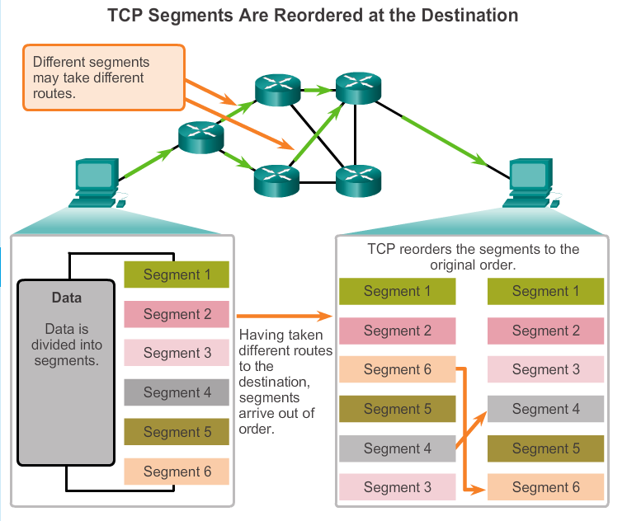
1.

Slide 30
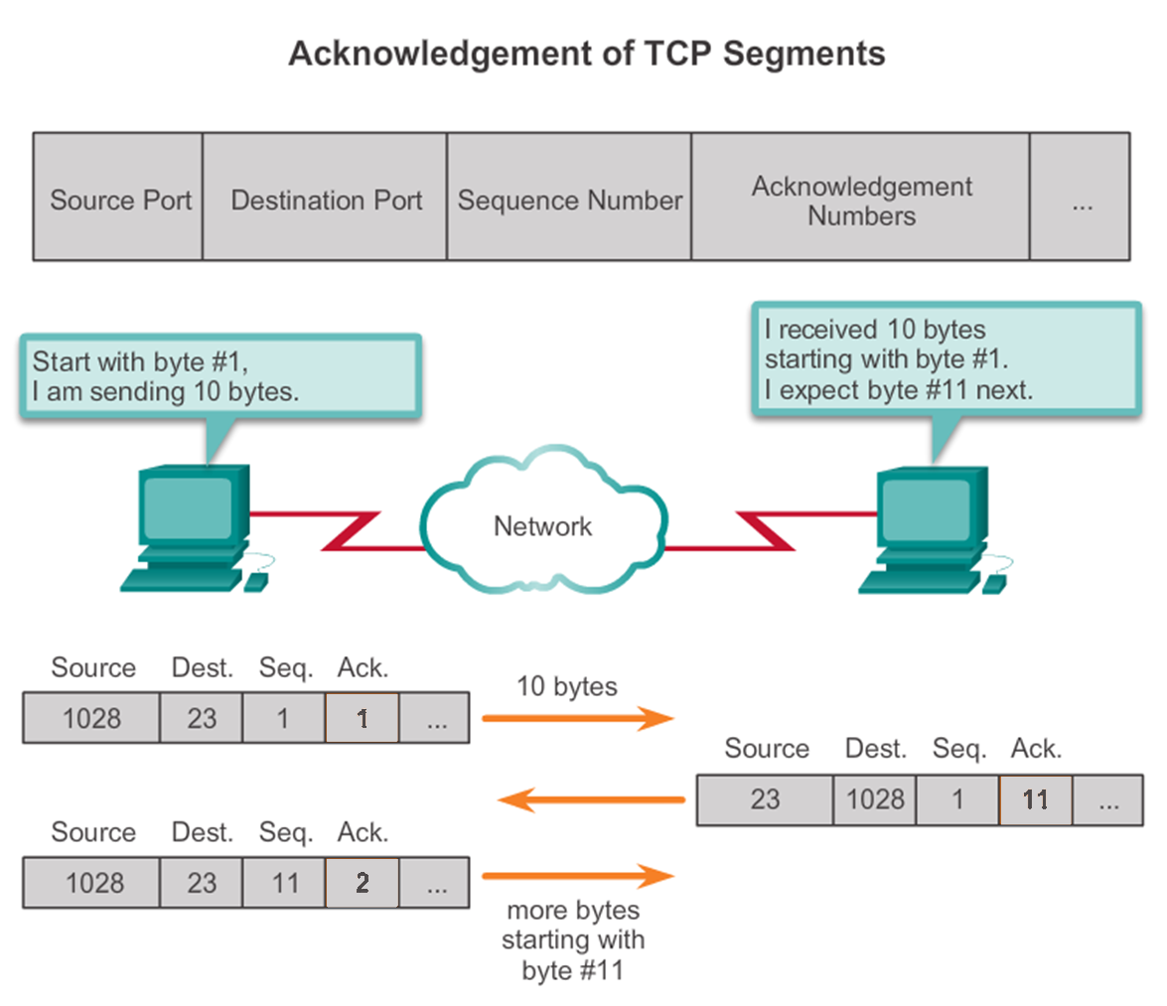
2.

Slide 32

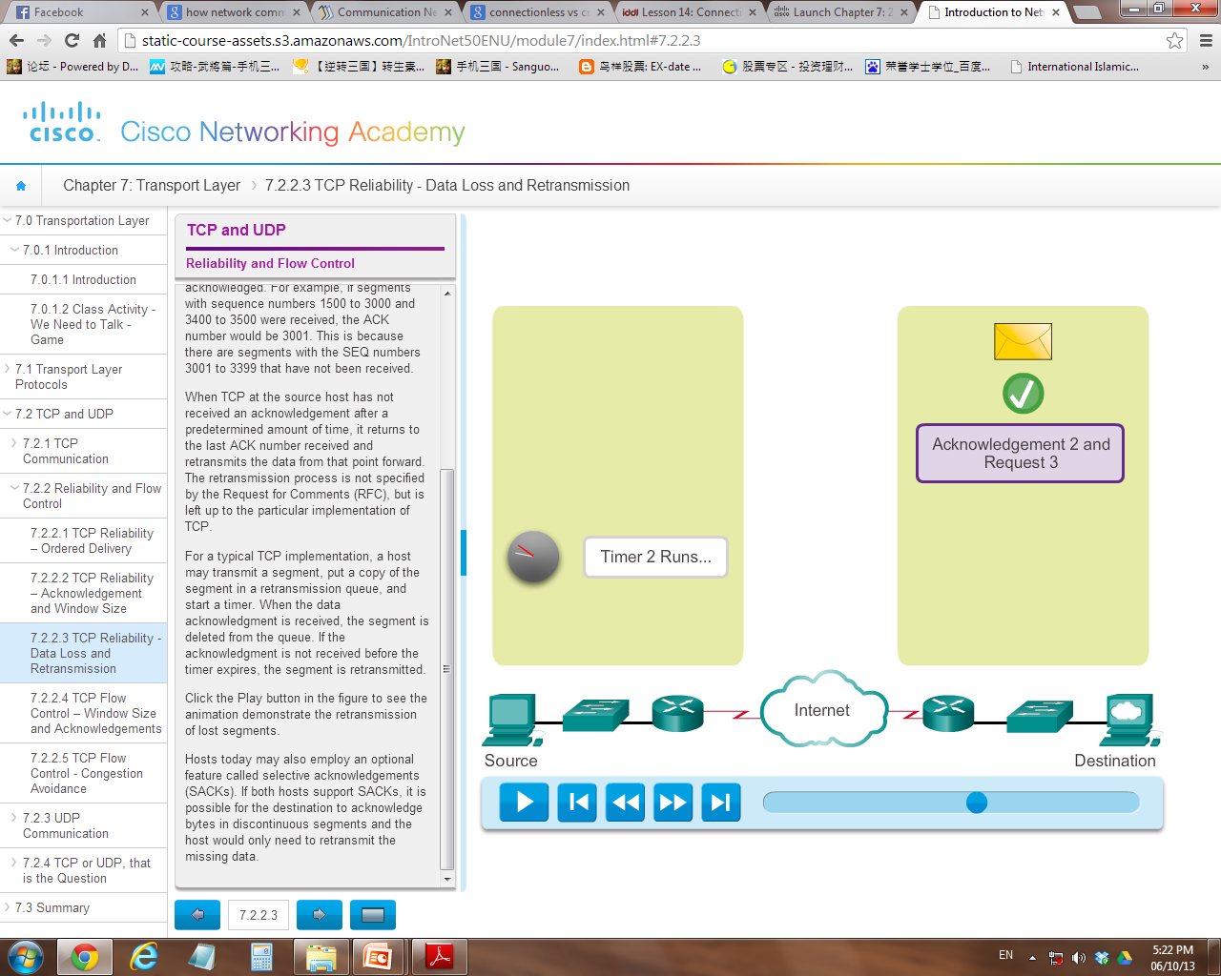
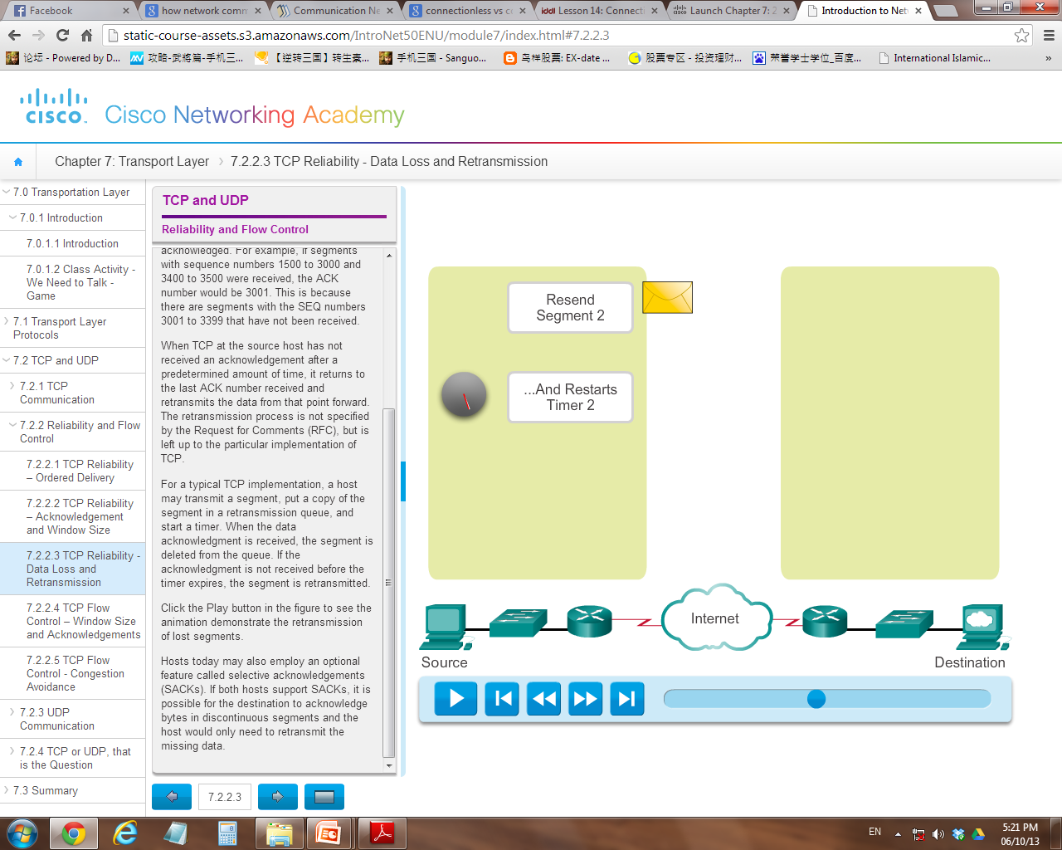
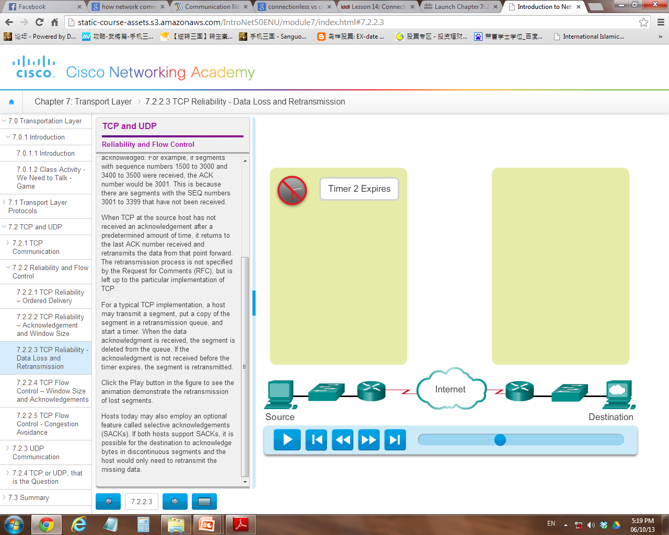
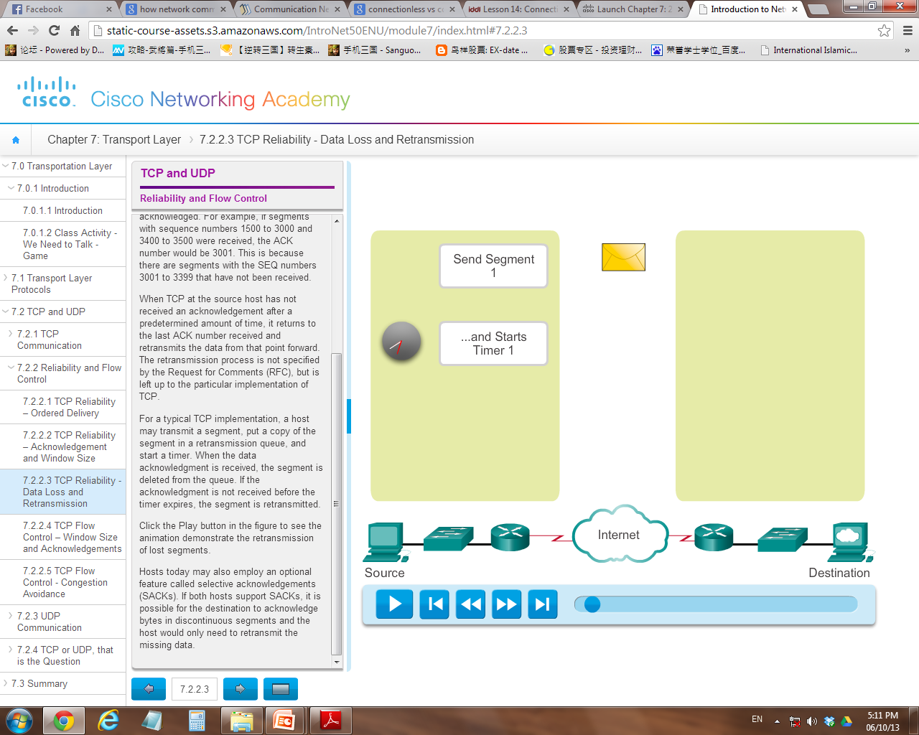
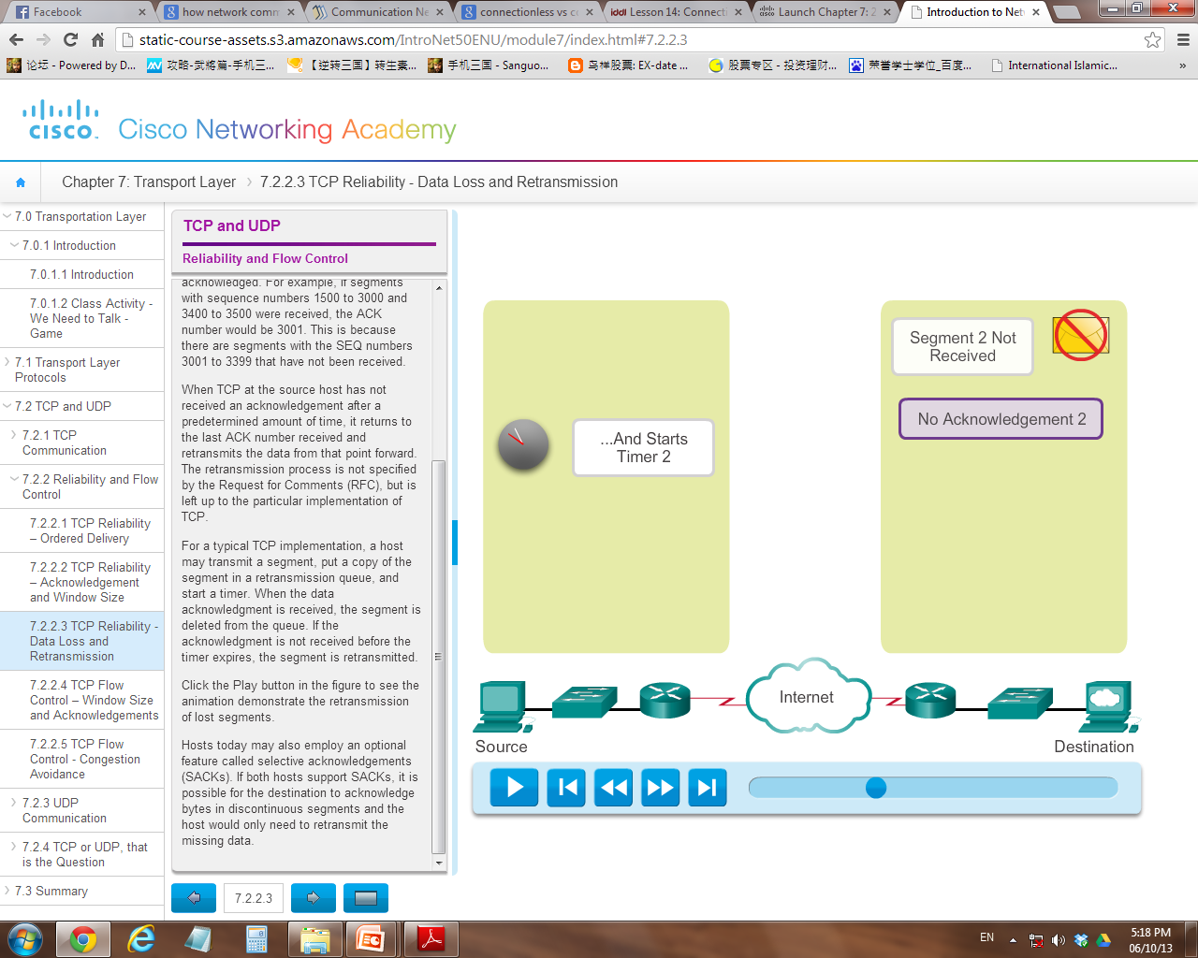

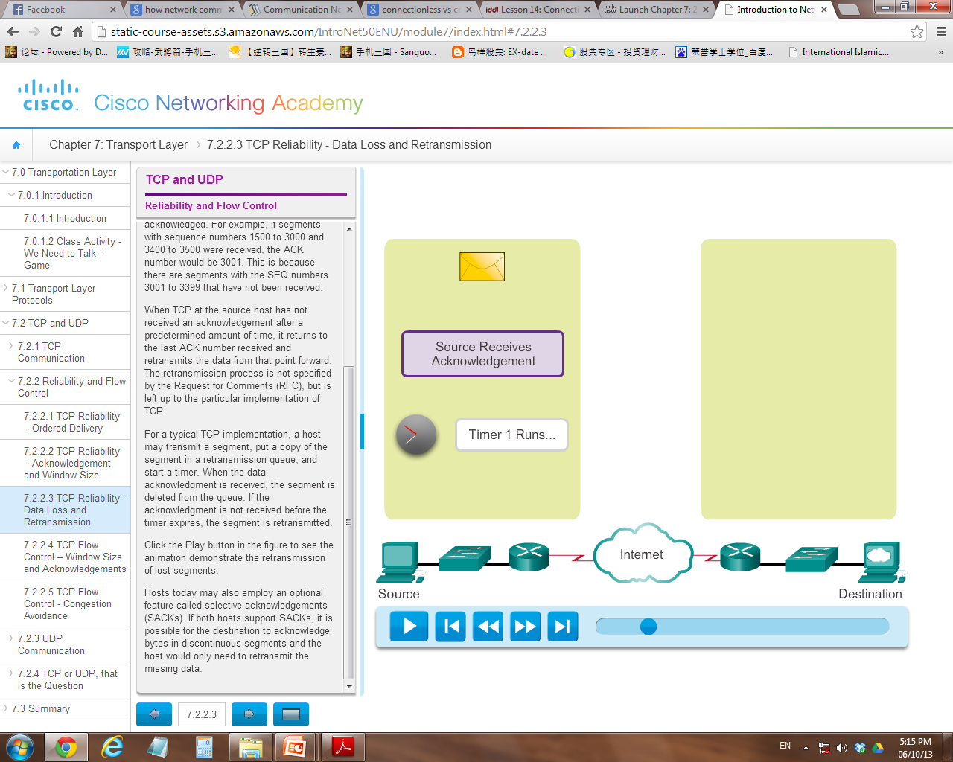
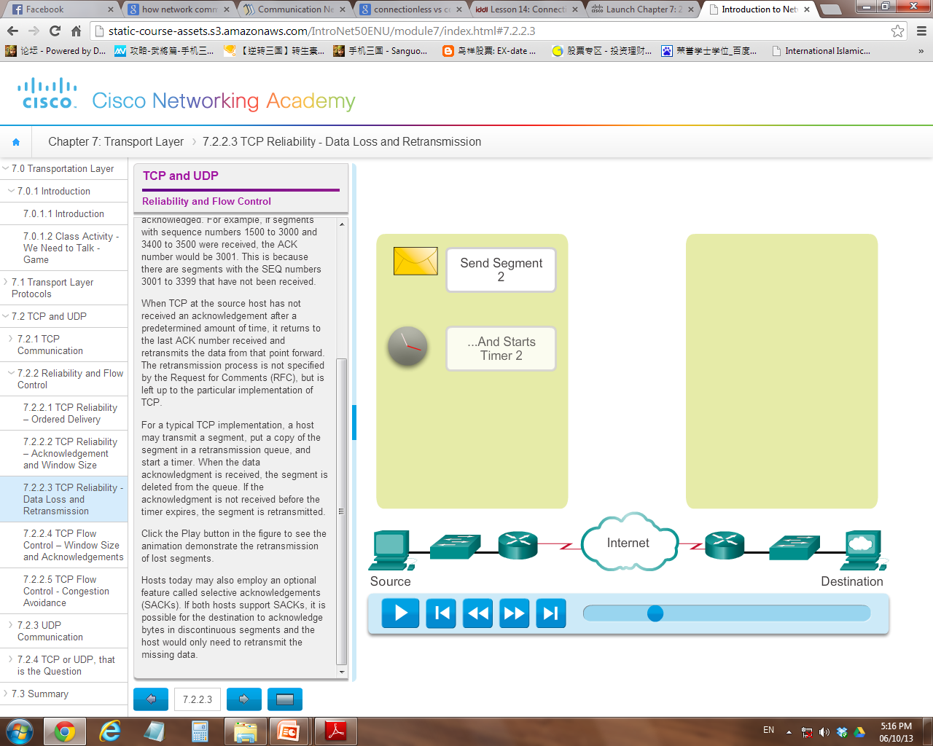
3.
TCP retransmission process

Slide 33
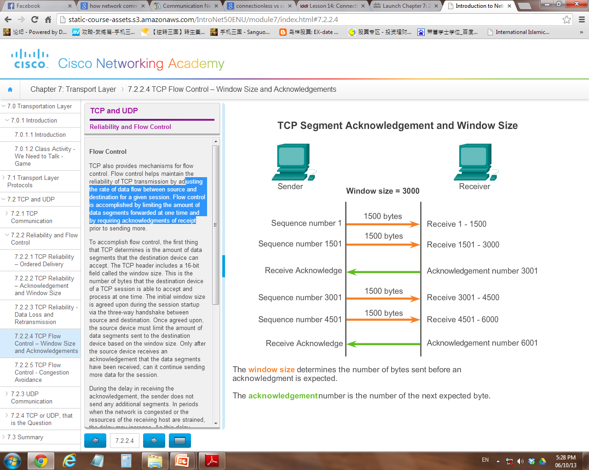
4.
Flow control
Flow control → Adjusting the rate of data flow (Window size) forwarded at a time before requiring an acknowledgments of receipt

Slide 35
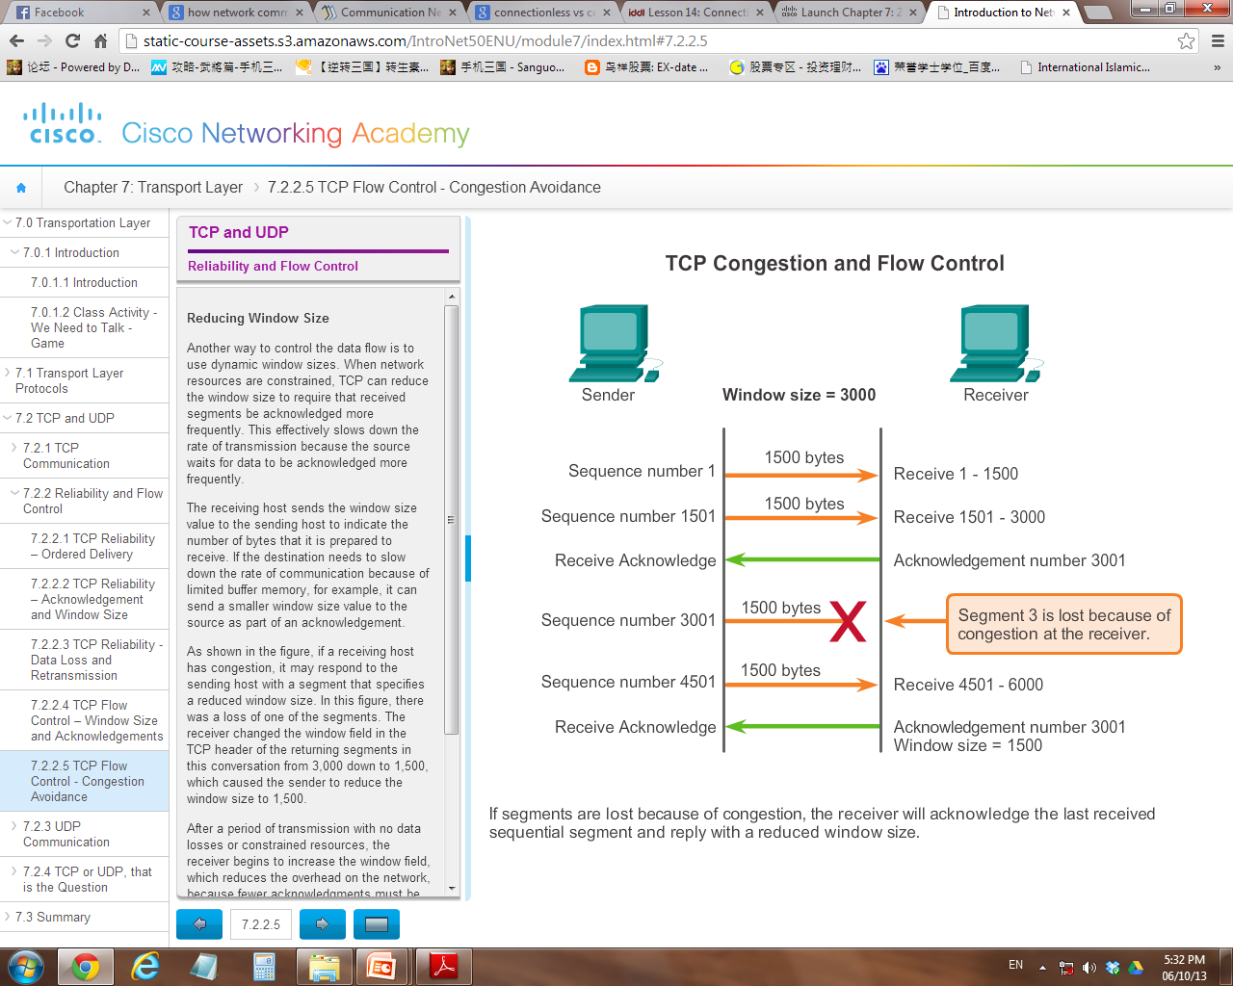
If a receiving host has congestion, it may respond to the sending host with a segment with a reduced window size.

Slide 36
Cont’d…
UDP is a very simple protocol that does not provide for any reliability (ie. it does not keep track of sequence no, no way to reorder, does not retransmit)
Datagrams are sent one at a time and assume “Best Effort” because there is no acknowledgement that the data is received at the destination.
Analogy: Postal service

Slide 37
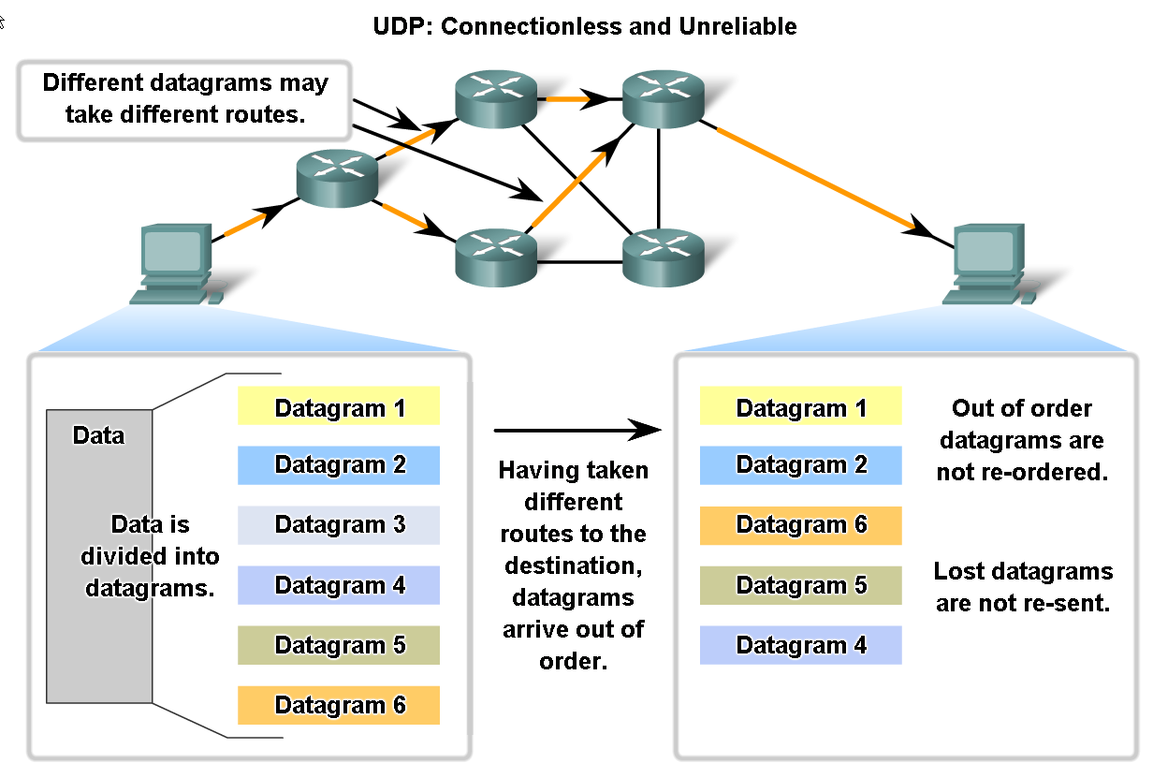

Slide 39
Cont’d…
Identifying the correct application
Both TCP and UDP use port number to identify the sending / receiving application
The port numbers are included into the Transport Header of Segment / Datagram
Port numbers range from 0 – 65,535

Slide 40
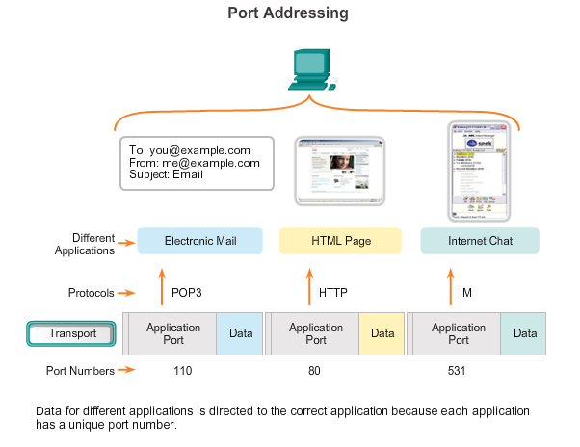

Slide 41
Cont’d…
3 categories of Port numbers:
(i) Well-known ports (0 – 1023)
Reserved for common services and applications eg. HTTP, SMTP, DNS so that client can be programmed to connect to the specific service
(ii) Registered port (1024 – 49151)
Numbers are assigned to user processes or applications that individual chooses to install eg. MSN messenger
(iii) Dynamic or Private Ports (49152 – 65535)
Temporarily ports that dynamically assigned to client applications when initiating a connection. Usually use in P2P communication

Slide 42
Which categories these port numbers belong to ?
Port Number | Application | Layer 4 Protocol | Description
20 | FTP | TCP | File Transfer Protocol – Data
21 | FTP | TCP | File Transfer Protocol – Control Commands
23 | TELNET | TCP | Terminal connection
25 | SMTP | TCP | Simple Mail Transfer Protocol - Email
53 | DNS | UDP | Domain Name System
67,68 | DHCP | UDP | Dynamic Host Configuration Protocol
69 | TFTP | UDP | Trivial File Transfer Protocol
80 | HTTP | TCP | Hypertext Transfer Protocol

Slide 43
Cont’d…
How about source client port ?
Each application process running on the server is configured to use a port number, either by default or manually by a system administrator.
An individual server cannot have two services assigned to the same port number within the same Transport layer services.
Eg. a host running a web server application and a file transfer application cannot have both configured to use the same port (for example, TCP port 80)

Slide 44
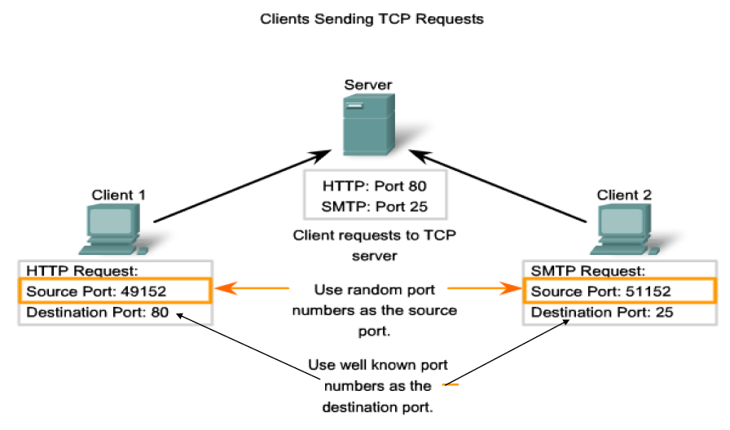

Slide 45
Socket Pairs
The combination of the source IP address and source port number, or the destination IP address and destination port number is known as a socket.
Sockets enable multiple processes, running on a client, to distinguish themselves from each other, and multiple connections to a server process to be distinguished from each other

Slide 46
Chapter Summary
Roles of Transport Layer
Two protocols involved: TCP and UDP
Differences between TCP and UDP

